Slide 1

Project and Laboratory 2017/2018
Antonio Nunnari
Salvatore Zaccaria
Andrea Mora
Teacher: Prof. Guido Albertengo
Assistent: Idilio Drago

Slide 2


INTRODUCTION
Feature
The sensors acquire measures and send to amazon’s cloud
Linkage & Data Access
Wi-fi module
Database on SD card
Management
Web Site
PURPOSE: take measures and send them to the cloud
Storage on SD card
Connection via Wi-Fi
Data presentation on Web Site

Slide 3
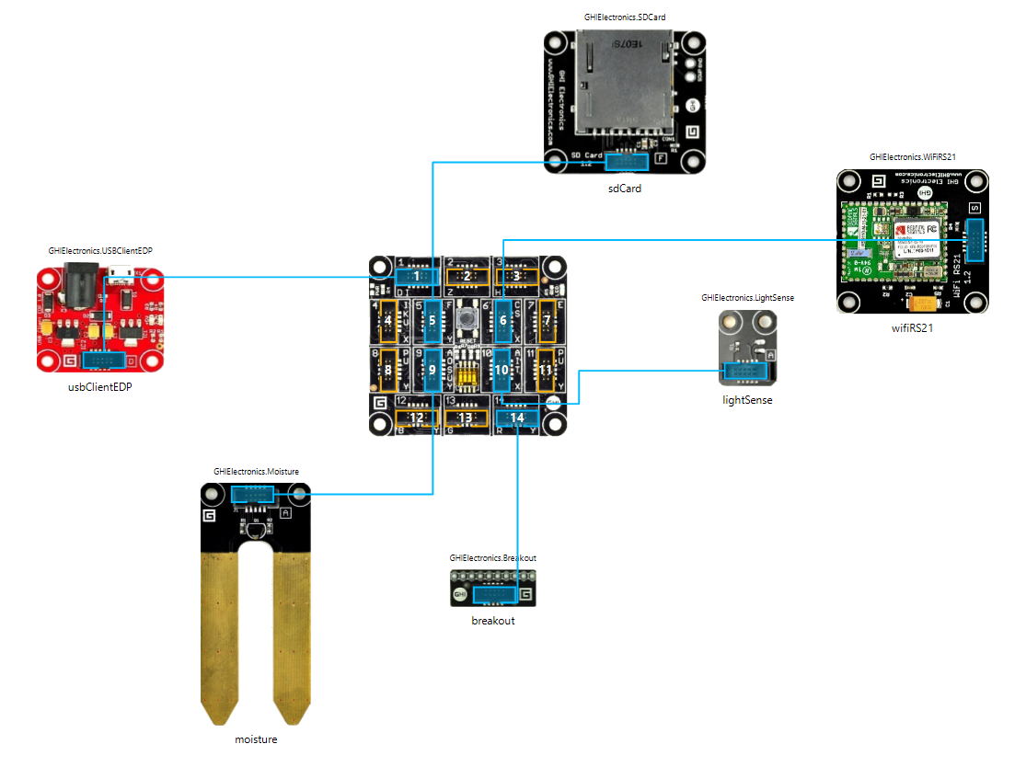
HARDWARE COMPONENTS
FEZ Mainboard
SD Card
Moisture
Lightsense
DHT11(via breakout)
Wi-Fi
Temperature and humidity: DHT11 (14).
incompatible comunication protocol
Lightsense (10)
Moisture (9)
Wi-Fi (6)
No cablage
Increase portability
SD card (5)
database

Slide 4
STORAGE ON FEZ
A record in database contains the principal information of one measure
Sensor Name
Sensor type
Univocal Id
Timestamp
Measure time
Value
Sequence Number
Measure value
In order to delete sended packet
Sensor Id

Slide 5
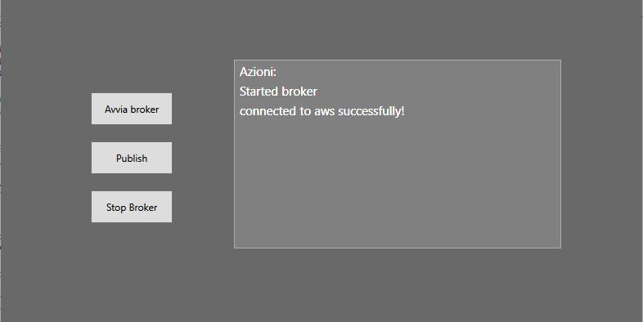
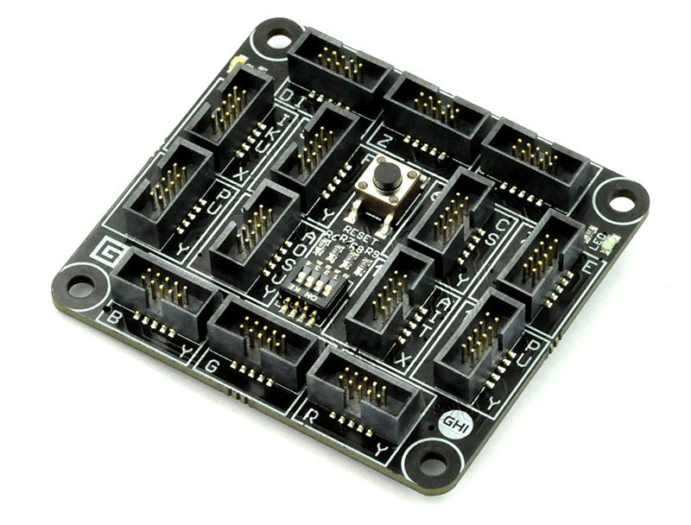

BROKER
JSON
JSON
ACK
ACK
Broker acts as a bridge
For ack and datas
Graphic user interface
Send own IP for connection with fez

Slide 6





WORKFLOW
NTP server
Sensors
6 seconds
Save
Database
FEZ board

Slide 7

WORKFLOW
NTP server
Sensors
2 minutes
6 seconds
BROKER
Save
Send data
Retrive data
Data
Database
FEZ board

Slide 8


WORKFLOW
NTP server
Sensors
2 minutes
6 seconds
BROKER
Save
Send data
Retrive data
Ack
Send Data
Data
AWS IOT
Database
FEZ board
Delete Data
Ack
AWS S3

Slide 9



WORKFLOW
NTP server
Sensors
2 minutes
6 seconds
BROKER
Save
Send data
Retrive data
Ack
Send Data
Data
AWS IOT
Database
FEZ board
Delete Data
Ack
WEB SITE
Request Data
Reply Data
AWS S3

Slide 10
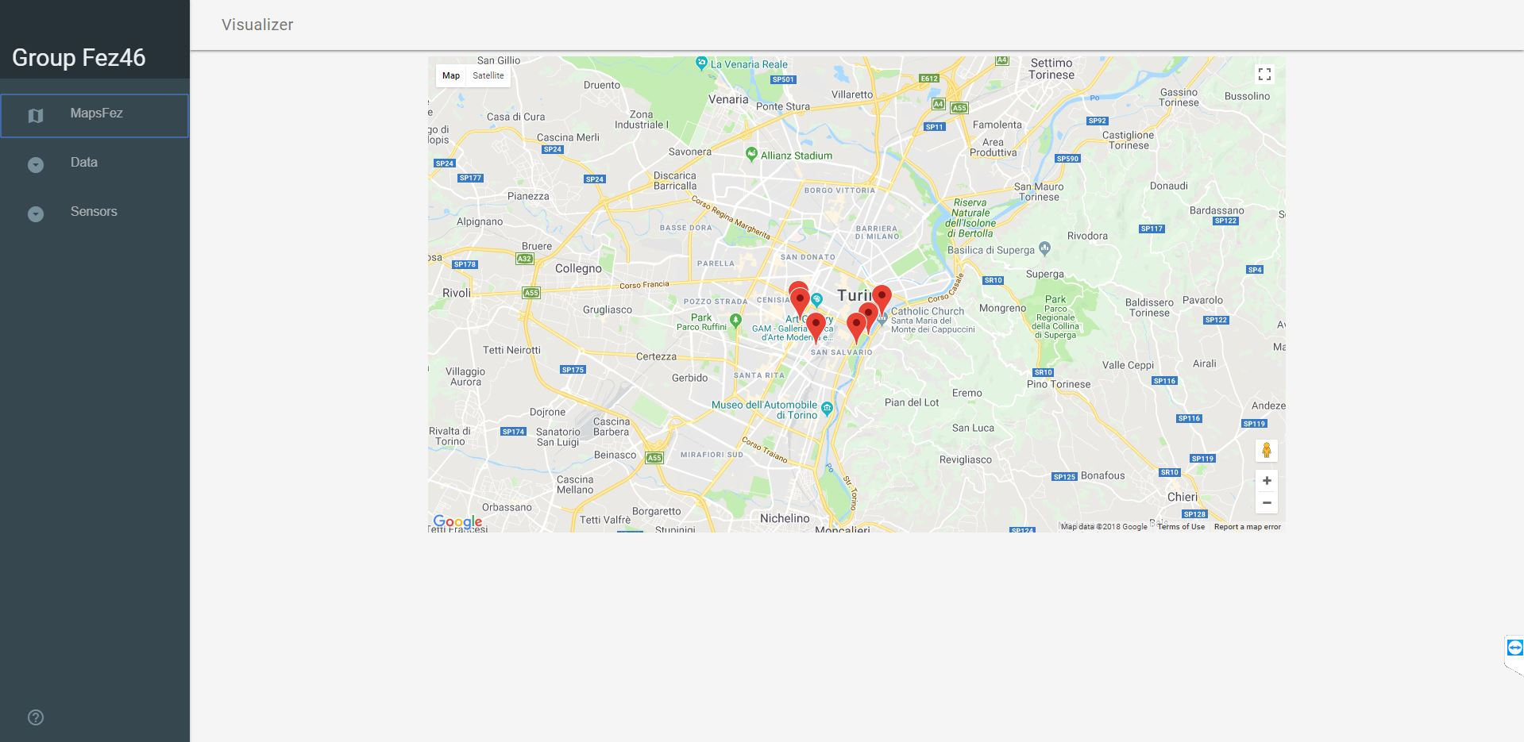
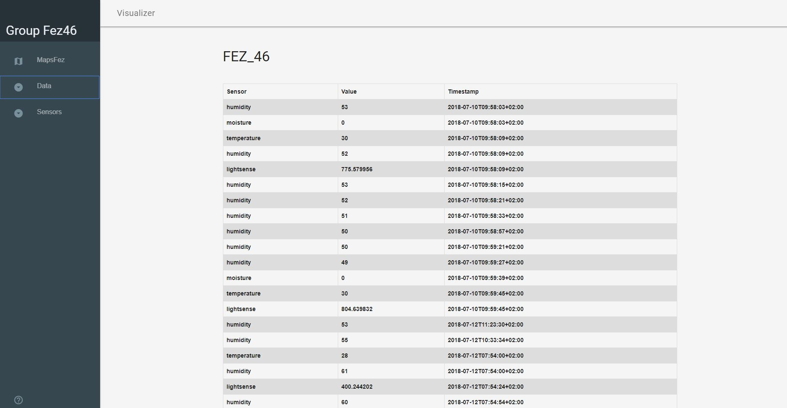
WEB-SITE
FEZ map location
Data Table

Slide 11
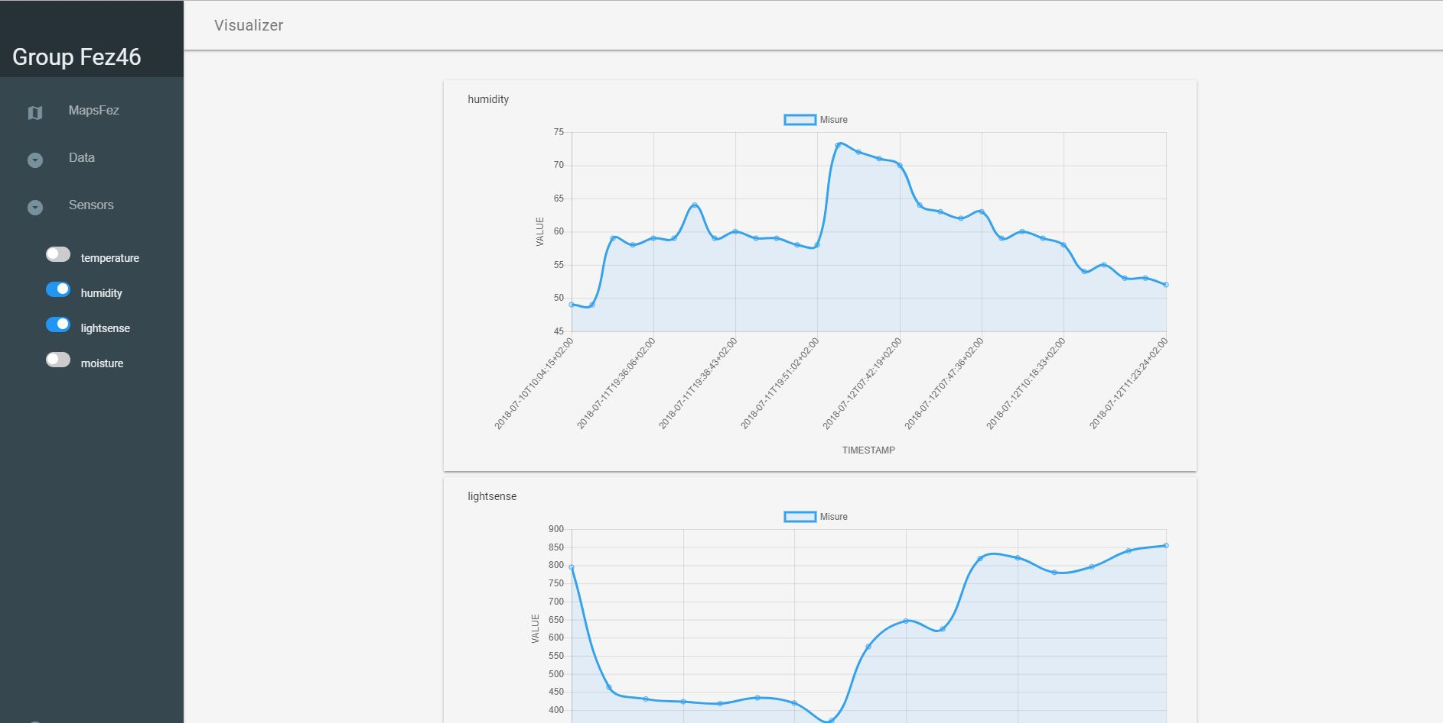
WEB-SITE
FEZ graphs

